Slide 1
Supply Chain Management & Analytics
Training material
April 2013

Slide 2
Why do you need to know about Supply Chain Management?
Estimated that the grocery industry could save $30 billion (10% of operating cost) by using effective logistics and supply chain strategies
A typical box of cereal spends 104 days from factory to sale
A typical car spends 15 days from factory to dealership
Compaq estimates its loss of $0.5 B to $1 B in sales because laptops were not available when and where needed
National Semiconductor used air transportation and closed 6 warehouses, 34% increase in sales and 47% decrease in delivery lead time.
P&G (Proctor & Gamble) estimates it saved retail customers $65 M (in 18 months) by collaboration resulting in a better match of supply and demand
When the 1 gig processor was introduced by AMD (Advanced Micro Devices), the price of the 800 meg processor dropped by 30%
Eliminating inefficiencies in supply chains can save millions of $.

Slide 3
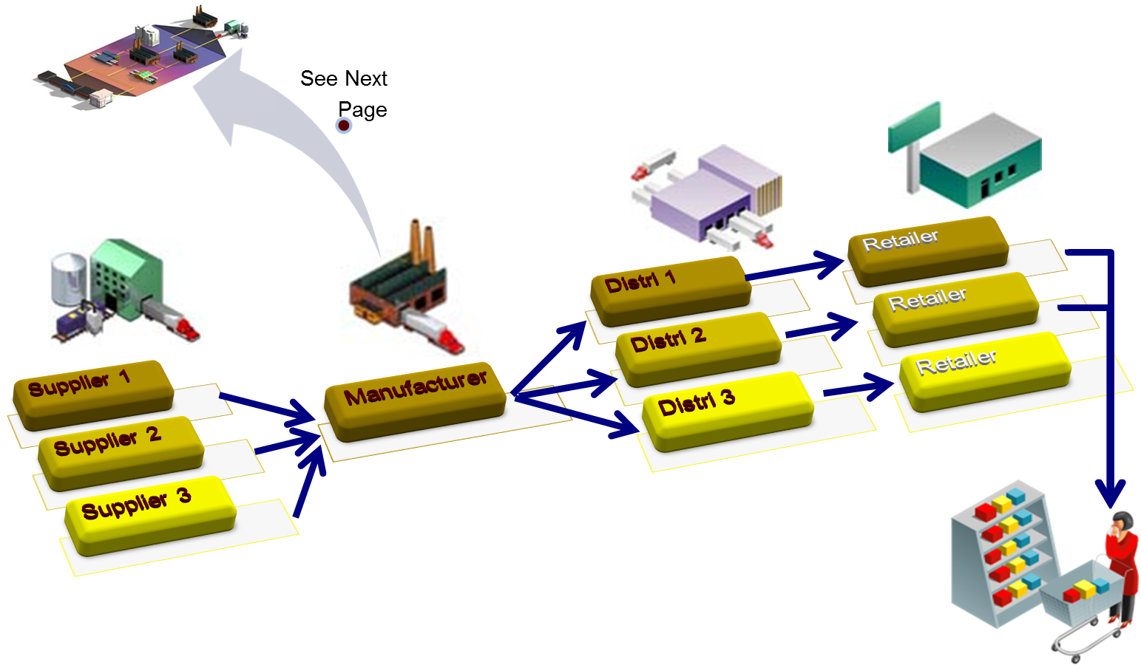
A Simple Supply Chain – 1/2

Slide 4
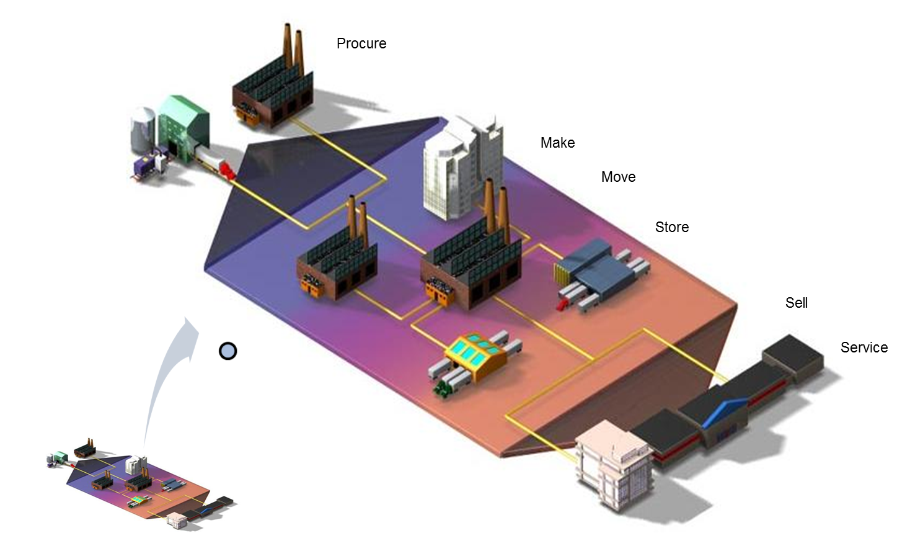
A Simple Supply Chain – 2/2

Slide 5
What is Supply Chain Management?
“Supply Chain Management is the management of money, material and information associated with the flow and transformation of goods from raw materials to finished goods, to achieve a sustainable competitive advantage”
A Supply Chain broadly comprises three tiers – Suppliers, Manufacturers and Distributors
It may include sub-functions like new product development, systems management, operations and assembly, purchasing, production scheduling, order processing, inventory management, transportation, warehousing, and customer service

Slide 6

A picture is better than 1000 words!
A supply chain consists of
Supplier
Manufacturer
Distributor
Retailer
Customer
Upstream
Downstream
Aims to Match Supply and Demand, profitably for products and services
SUPPLY SIDE
DEMAND SIDE
Achieves
+
+
+
+
+
=
The right
Product
The right
Price
The right
Store
The right
Quantity
The right
Customer
The right
Time
Higher
Profits

Slide 7
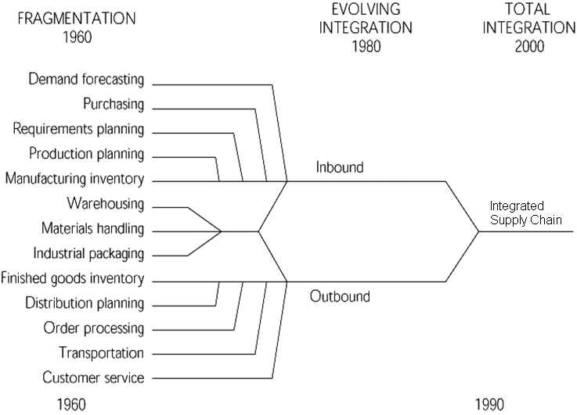
How did Supply Chain Management evolve?

Slide 8
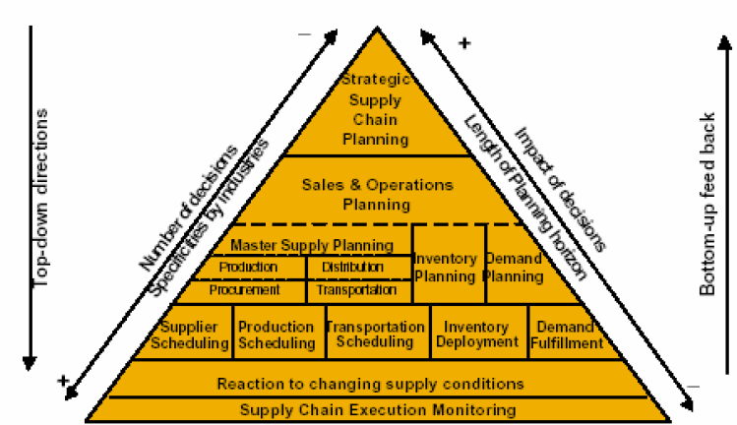
What are the key processes in a supply chain?

Slide 9
Examples - 1
DELL: e-commerce and customization.
Zara: innovative versus functional products.
Toyota: efficient production.
Amazon / Borders / Barnes and Noble: bad synchronization between physical flow and e-commerce.
Wal-Mart: cross-docking, VMI, super Wal-Mart, data mining …etc.

Slide 10
Examples - 2
P&G or other
manufacturer
Wal-Mart or third
party DC
Wal-Mart
Supermarket
Customer wants
detergent and goes to Wal-Mart
Plastic
Producer
Tenneco
Packaging
Chemical
manufacturer
(e.g. Oil Company)
Chemical
manufacturer
(e.g. Oil Company)
Paper
Manufacturer
Timber
Industry

Slide 11
Why is Supply Chain management difficult?
Plan
Source
Make
Deliver
Buy
Uncertainty is inherent to every supply chain
Travel times
Breakdowns of machines and vehicles
Weather, natural catastrophe, war
Local politics, labor conditions, border issues
The complexity of the problem to globally optimize a supply chain is significant
Minimize internal costs
Minimize uncertainty
Deal with remaining uncertainty

Slide 12
Examples
Dealing with uncertain environments – matching supply and demand
Boeing announced a $2.6 billion write-off in 1997 due to “raw materials shortages, internal and supplier parts shortages and productivity inefficiencies”
U.S Surgical Corporation announced a $22 million loss in 1993 due to “larger than anticipated inventories on the shelves of hospitals”
IBM sold out its supply of its new Aptiva PC in 1994 costing it millions in potential revenue
Hewlett-Packard and Dell found it difficult to obtain important components for its PC’s from Taiwanese suppliers in 1999 due to a massive earthquake
U.S. firms spent $898 billion (10% of GDP) on supply-chain related activities in 1998

Slide 13
Examples
Shorter product life cycles of high-technology products
Less opportunity to accumulate historical data on customer demand
Wide choice of competing products makes it difficult to predict demand
The growth of technologies such as the Internet enable greater collaboration between supply chain trading partners
If you don’t do it, your competitor will
Major buyers such as Wal-Mart demand a level of “supply chain maturity” of its suppliers
Availability of SCM technologies on the market
Firms have access to multiple products (e.g., SAP, Baan, Oracle, JD Edwards) with which to integrate internal processes

Slide 14
Why is Supply Chain management difficult?
Inventory and back-order levels fluctuate considerably across the supply chain even when customer demand doesn’t vary
The variability worsens as we travel “up” the supply chain
Forecasting does not help!
Multi-tier
Suppliers
Wholesale Distributors
Manufacturer
Retailers
Consumers
Sales
Sales
Sales
Sales
Time
Time
Time
Time
Bullwhip Effect

Slide 15
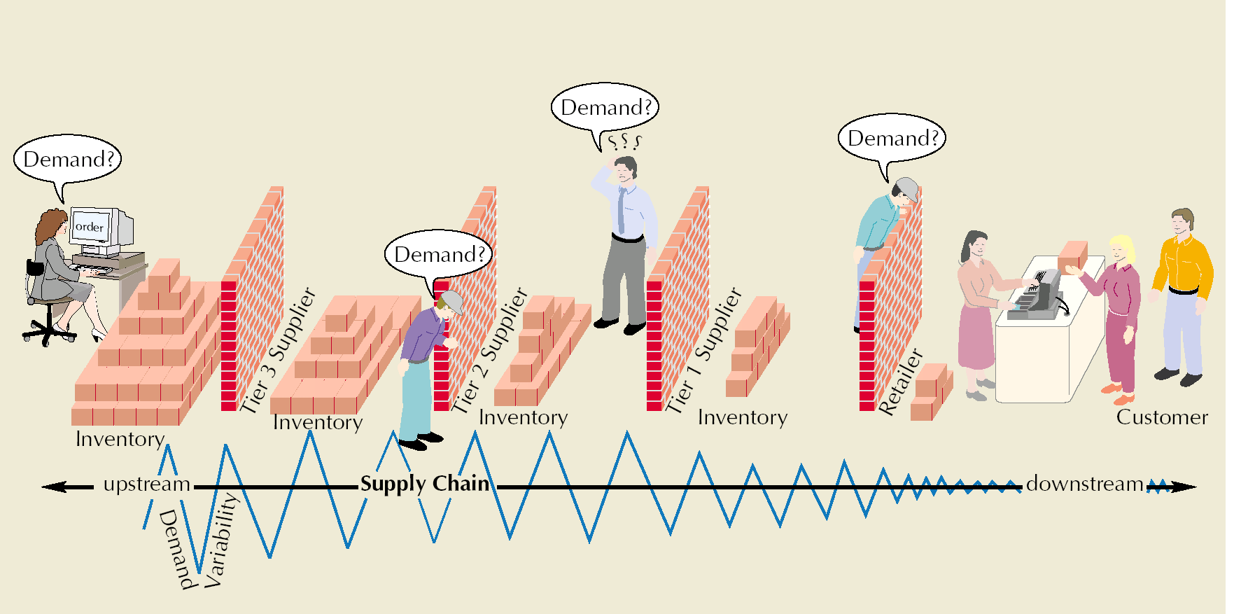
Bullwhip Effect
Occurs when slight demand variability is magnified as information moves back upstream

Slide 16
Taming the bull-whip effect
Reduce uncertainty in the supply chain
Centralize demand information and improve forecasting process
Continuous planning and tracking: JIT style of management
Order synchronization and warehouse efficiency methods
Reduce variability in the supply chain
Planned pricing and promotional strategies to reduce variance in customer demand
Reduce lead times
Use cross-docking to reduce order lead times
Use EDI techniques to reduce information lead times
Vendor assessment
Eliminate the bullwhip through strategic partnerships
Vendor-managed inventory (VMI)
Collaborative planning, forecasting and replenishment (CPFR)
http://www.aalhysterforklifts.com.au/index.php/about/blog-post/what_is_the_bullwhip_effect_understanding_the_concept_definition

Slide 17


Push strategies
Classical manufacturing supply chain strategy
Manufacturing forecasts are long-range
Orders from retailers’ warehouses
Longer response time to react to marketplace changes
Unable to meet changing demand patterns
Supply chain inventory becomes obsolete as demand for certain products disappears
Increased variability (Bullwhip effect) leading to:
Large inventory safety stocks
Larger and more variably sized production batches
Unacceptable service levels
Inventory obsolescence
Inefficient use of production facilities (factories)
How is demand determined? Peak? Average?
How is transportation capacity determined?
Examples: Auto industry, large appliances, others?

Slide 18


Pull strategies
Production and distribution are demand-driven
Coordinated with true customer demand
None or little inventory held
Only in response to specific orders
Fast information flow mechanisms
POS data
Decreased lead times
Decreased retailer inventory
Decreased variability in the supply chain and especially at manufacturers
Decreased manufacturer inventory
More efficient use of resources
More difficult to take advantage of scale opportunities
Examples: Dell, Amazon

Slide 19
Push v/s Pull strategies
 | PUSH | PULL
Objective | Minimize Cost | Maximize Service Level
Complexity | High | Low
Focus | Resource Allocation | Responsiveness
Lead Time | Long | Short
Processes | Supply Chain Planning | Order Fulfillment

Slide 20

Hybrid model
Hybrid of “push” and “pull” strategies to overcome disadvantages of each model
Early stages of product assembly are done in a “push” manner
Partial assembly of product based on aggregate demand forecasts (which are more accurate than individual product demand forecasts)
Uncertainty is reduced so safety stock inventory is lower
Final product assembly is done based on customer demand for specific product configurations
Supply chain timeline determines “push-pull boundary”
Push-Pull
Boundary
“Generic” Product
“Customized” Product
Push Strategy
Pull Strategy
Raw
Materials
End
Consumer
Supply Chain Timeline

Slide 21
When to choose which model?
Pull
High
Where do the following industries fit in this model:
Automobile?
Aircraft?
Fashion?
Petroleum refining?
Pharmaceuticals?
Biotechnology?
Medical Devices?
Industries where:
Customization is High
Demand is uncertain
Scale economies are Low
Industries where:
Demand is uncertain
Scale economies are High
Low economies of scale
Computer equipment
Furniture
Demand Uncertainty
Industries where:
Uncertainty is low
Low economies of scale
Push-pull supply chain
Industries where:
Standard processes are the norm
Demand is stable
Scale economies are High
Books, CD’s
Grocery,
Beverages
Push
Low
Low
Economies of Scale
High
Pull
Push
Source: Simchi-Levi

Slide 22




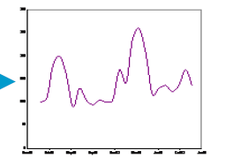



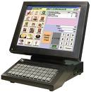
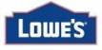



Demand planning and forecasting
Minimal manual intervention
(Calculate Trend)
MACROECONOMIC FACTORS
PROMOTIONS
(Estimate Level)
HISTORICAL POS DATA
MARKDOWNS
STATISTICAL FORECAST
EXTERNAL DEMAND DRIVERS
COMPETI-TION
CO-PURCHASE
HOLIDAYS
WEATHER PATTERNS
(Compute Seasonality)
Highly accurate forecast obtained by smoothening shipment data & accounting for causal factors
Reduce supply chain costs, overstocks & out-of-stocks by driving efficient inventory management

Slide 23
Demand planning and forecasting
Judgment Methods
Market Research Analysis
Panels of Experts
Internal experts
External experts
Domain experts
Delphi technique
Market testing
Market surveys
Focus groups
Time-Series Methods
Accurate
Forecasts
Causal Analysis
Moving average
Exponential smoothing
Trend analysis
Seasonality analysis
Relies on data other than that being predicted
Economic data, commodity data, etc.
22

Slide 24
Inventory Management
Inventory is the stock of any item or resource used in an organization. An inventory system is the set of policies and controls that monitor levels of inventory and determine what levels should be maintained, when stock should be replenished, and how large orders should be.
The most frequently asked questions in Inventory Management are :-
When should I order?
How much should I order?

Slide 25
Based on the deterministic and the stochastic nature of the demand different types of inventory models were built
Inventory models
Deterministic Model
Probabilistic Model
Economic Order Quantity model (EOQ)
Price Break Model
Sensitivity Analysis
Single Period Model
Fixed – Order Quantity Model
Fixed – Time Period Model

Slide 26
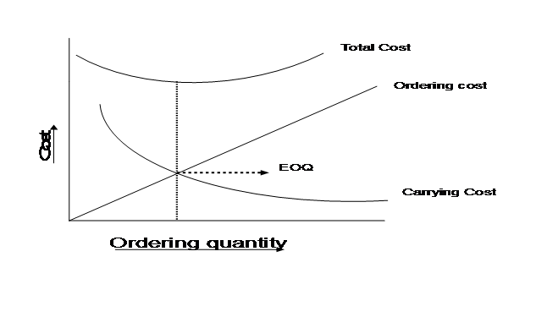
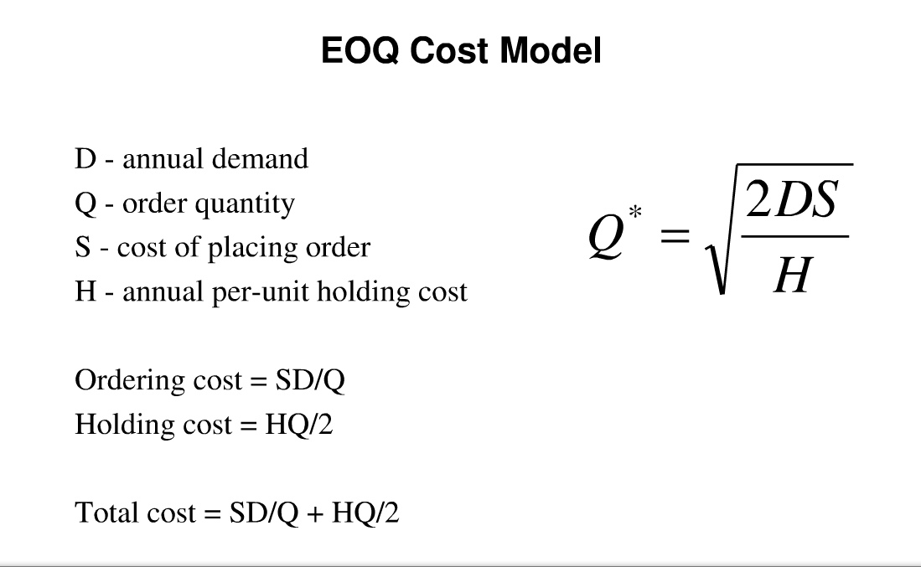
EOQ Model

Slide 27
Probabilistic Model
The single-period model. This is used when we are making a one-time purchase of an item. An example might be purchasing T-shirts to sell at a one-time sporting event.
Fixed–order quantity model. This is used when we want to maintain an item “in-stock,” and when we resupply the item, a certain number of units must be ordered each time. Inventory for the item is monitored until it gets down to a level where the risk of stocking out is great enough that we are compelled to order.
Fixed–time period model. This is similar to the fixed–order quantity model; it is used when the item should be in-stock and ready to use. In this case, rather than monitoring the inventory level and ordering when the level gets down to a critical quantity, the item is ordered at certain intervals of time.

Slide 28
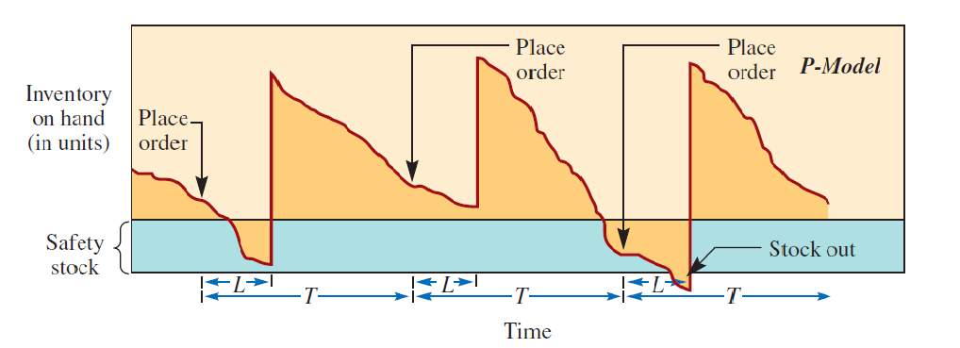
Wal-Mart Follows Fixed Periodic review model
Wondering, What are all these terminologies in the picture?

Slide 29
Inventory planning and replenishment
What is safety stock?
Why is it necessary?
How to compute safety stock for a set service level?
What are some important assumptions to keep in mind while using a closed form solution?
1. Z: NORMSINV(Service level), for example Z=1.64 for a 95% service level
2. Safety stock: {Z*SQRT(Avg. Lead Time * Standard Deviation of Demand^2 + Avg. Demand^2 * Standard Deviation of Lead Time^2)}
3. Re-order Point (ROP): Average Lead Time*Average Demand + Z*SQRT(Avg. Lead Time * Standard Deviation of Demand^2 + Avg. Demand^2 * Standard Deviation of Lead Time^2)
inventory level
Demand rate
Reorder Point
Reorder Quantity
Safety Stock
time
Lead Time

Slide 30
Safety stock
% of total area = CSL
Probability Distribution of demand within lead time
P(x)
Demand within lead time (x)
S
Safety Stock
We use math to combine the probability distributions for demand risk and for supply risk into a single probability distribution for demand inside of lead time
Safety stock is selected as the quantity from this combined probability distribution that represents the percentile of the distribution equal to the desired CSL
S= Re-order Point = Safety Stock + Mean Lead Time Demand
Safety Stock accounts for the variability of demand within the lead time resulting out of supply as well as demand risks
Safety Stock is calculated for each SKU, Location, Time period combination
Lead Time demand is purely deterministic and is based on CSL of intermediate nodes and mean supply lead time
For every replenishment cycle , an order , of size equal to ( safety stock + lead time demand + cycle stock ), is placed

Slide 31
Trade-Off with Safety Stock
Safety Stock – Stock held in excess of expected demand against stock out during Lead time
Safety Stock Holding Cost Stock out
Safety Stock Holding Cost Stock out

Slide 32
Acceptable level of Stock Outs
Ask The Manager!!!
Acceptable level of stock outs depends on the managements tolerance
A related term is Service level
Wal-Mart Follows 98% service levels

Slide 33
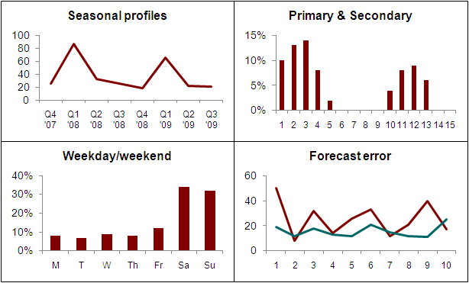
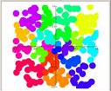
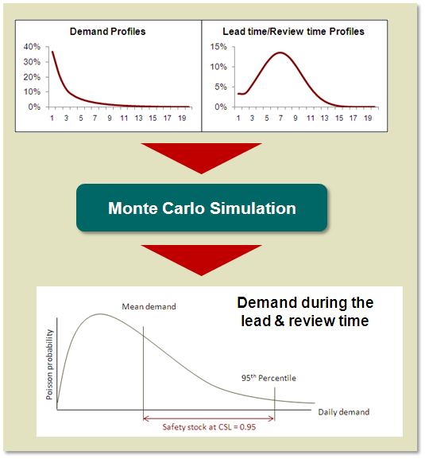
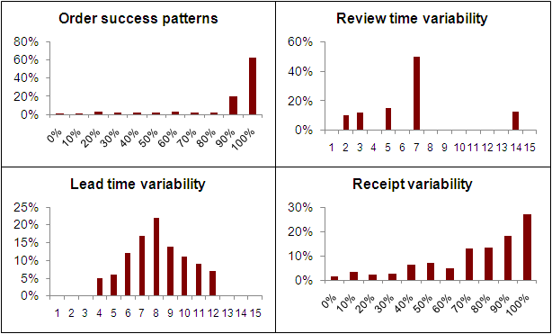
Safety stock and order simulation
Step 1: Analyze demand & order patterns
Step 2: Cluster SKUs
Group SKUs based on variability & assign specific inventory policies for a similar set of products
Step 3: Calculate order quantity for each SKU
A Monte Carlo simulation method is used to generate the theoretical demand during the order cycle
Set appropriate SLs based on volume & velocity
Generate demand distributions during the order cycle & determine EOQs
Evaluate validation metrics like number of stock outs and theoretical SL achieved

Slide 34
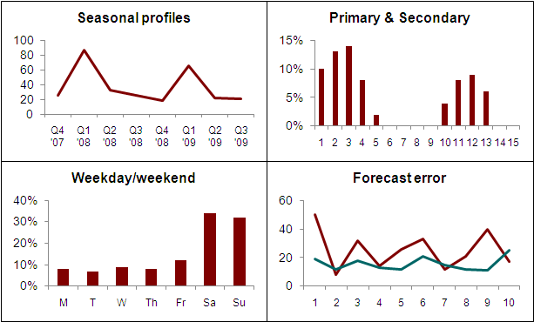
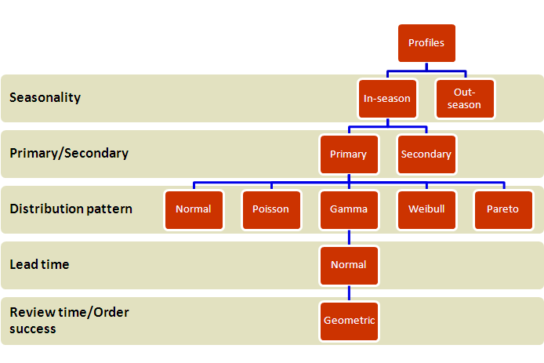
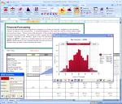
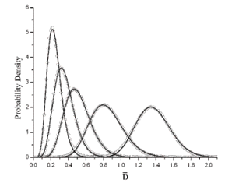
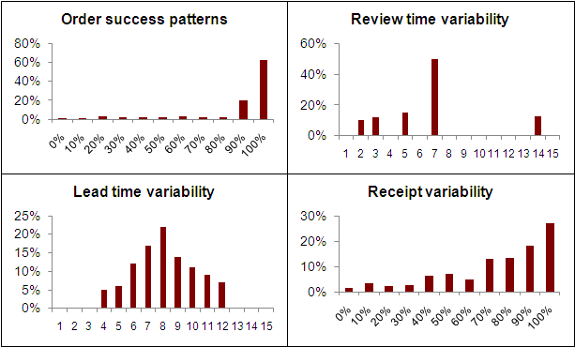
Inventory Optimization: Inventory Planning & Replenishment
For a retailer, Mu Sigma developed the most comprehensive methodology to compute inventory levels for every store-SKU combination
Text book solutions assume that the demand during the order cycle is normally distributed & use a closed form solution
Packaged solutions use this methodology as a base & tweak it to approximately account for different distributions
Because of this approximation, packaged solutions generally do not handle JLQ SKUs, SKUs with lumpy demand and SKUs with a long-tail distributions that require a very high service levels.
However, packaged solutions scale well & have high processing speeds
1
2
JLQ SKU
3
Monte Carlo
4
Overlapped
2 x 2 x 5 x 1 x 1 = 20 Profiles
simulation
distributions
2
2
5
1
Use simulation & overlay several distributions to
construct custom distribution for demand during
1
order cycle
5
150
Model Validation
Process each store
Model Validation
-
SKU
Slot each store
-
SKU to one of 20 different profiles
individually to analyze various
using a “coin sorter” logic
100
demand & order profiles
4
We
arrived
here by analyzing 14,000 Store SKUs, building 20 profiles from 256
Units
50
combinations and conducting 30 million simulation trials to validate our models.
4
We have coded all the steps of our process and developed a tool using SAS, C#
0
4
We catch exceptions that are not handled by the tool and iteratively add
additional
9
10
11
12
13
14
15
16
17
18
19
20
21
22
23
24
25
26
27
28
29
30
31
logic into the tool in order to minimize exceptions
Actual sales
2009 week #
Simulated OH
Actual OH
4
Currently, the client IT team is improving the scalability of these models and
we are collaborating with the client to field-test these results
Use actual historical data to validate models with
discrete event simulation
Back

Slide 35
Components of a supply chain and analytical opportunity
Mu Sigma Case Studies
Supplier Management
Demand Planning
Replenishment Planning
Transportation Analytics
Warehouse Analytics
Metrics and Reporting
Supplier Performance Measurement
Sales Planning & Forecasting
Replenishment strategy design
Transportation
network design & analysis
Distribution network design and analysis
Supply chain health indicators
Supplier Segmentation
SKU level demand forecasting
Simulation based safety stock setting
Route
scheduling & Optimization
Distribution center consolidation analysis
Proactive
dashboards
Procurement cost optimization
Multi channel demand forecasting
Stock out prediction modeling
Carrier bid optimization
Incentive plan analysis for warehouse staff
Simulation based
stock out
dashboards
Supplier base rationalization
SKU lifecycle based forecasting
Inventory mix optimization
Inter modal transport model & analysis
Equipment maintenance and failure analysis
Channel inventory monitoring
Total landed cost computation
Sales driver analysis
Lost sales monitoring
Transportation cost allocation
DC productivity analysis
Lost sales dashboard
Promotion lift analysis
Slow-mover inventory planning
Reverse logistics
On-time Delivery Monitoring

Slide 36
Mu Sigma has worked with all the functions of a typical Supply Chain organization to solve high impact business problems
Mu Sigma Case Studies
SC Planning Organization
Demand Planning
Supply Planning
Distribution Planning
Capacity Planning
Network Planning
Network Planning to identify the optimal allocation of investments in the Supply Chain
Network Flow Optimization to establish the optimal fulfillment network
Labor Planning to optimize the workforce composition to support a Sales and Operations Plan (S&OP)
Capacity Planning to establish the planned capacity levels by manufacturing unit
Forecasting to develop/manage medium-term/short-term demand plans by product category/region to drive the Supply Organization
New Product Launch Planning during the product launch/pilot phases
Constrained Supply Planning to develop/manage plans to drive the procurement and manufacturing operations
Inventory Planning and Optimization to develop/manage optimal safety stock and replenishment strategies across the Supply Chain
Distribution Planning to develop/manage medium-term/short-term
Inventory Planning and Optimization to develop/manage optimal safety stock and replenishment strategies across the Supply Chain

Slide 37
To summarize….
Demand forecasting practices
Min-max inventory management (reorder points to bring inventory up to predicted levels)
Lead time
Longer lead times lead to greater variability in estimates of average demand, thus increasing variability and safety stock costs
Batch ordering
Peaks and valleys in orders
Fixed ordering costs
Impact of transportation costs (e.g., fuel costs)
Sales quotas
Price fluctuations
Promotion and discount policies
Lack of centralized information

